Slide 1
Inequality of “Knowledge”

Slide 2
Contents
Early Qualitative models of Knowledge
2. Bibliometrics ~ Statistics of Knowledge (written papers, journals, articles e.t.c.)
- Impact Factor
- h factor, Eigenfactor Score e.t.c
3. Inequality
- Ideal Cases ~ Perfect Equality, Inequality
- Lorenz Curve ~ g-index, k-index
4. Report Findings:
5. Conclusion

Slide 3
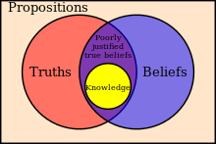

Models of knowledge (1800s ~ Now)
Empiricism
Idealism
Rationalism
.
Bayesian Epistemology
Sociological / Anthropological
Plato
Steup, Matthias, "Epistemology", The Stanford Encyclopedia of Philosophy (Fall 2016 Edition), Edward N. Zalta (ed.), URL = <https://plato.stanford.edu/archives/fall2016/entries/epistemology/>

Slide 4
Bibliometrics
h-factor
Impact Factor
Citing/Cited Half Life
Eigenfactor
Score
Notes:
Quantitative aspect of recorded information: bibliographic data

Slide 5
Measuring Inequality

Slide 6
Lorenz Curve
Max O. Lorenz in 1905 for representing inequality of the wealth distribution (“Economic theory of Railroads”)

Slide 7
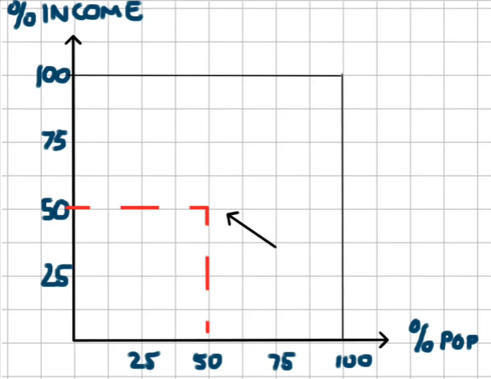
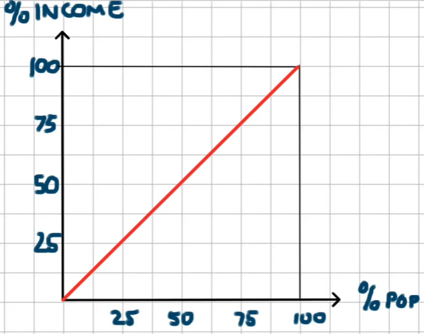
Perfect Equality

Slide 8
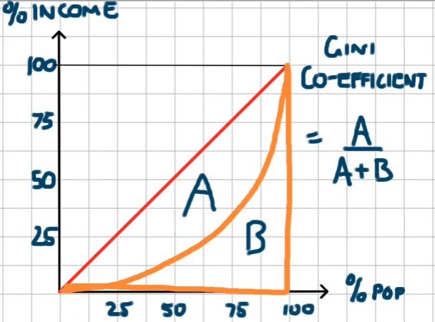
Gini-Coefficient

Slide 9
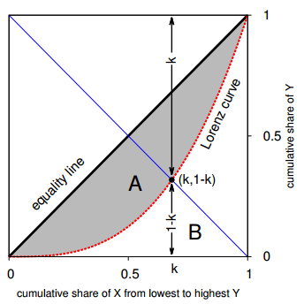
K-Index
A. Chatterjee , A. Ghosh, Jun-ichi Inoue, Bikas K. Chakrabarti 2015. Social inequality: from data to statistical physics modeling (IOP Science, 2015 J. Phys.: Conf. Ser. 638 012014)

Slide 10
Implementation
Calculate and Plot the Lorenz Curve
Calculate G-Value
Geometrically determine K-value
Compare and plot the G-K values (1997 - 2015)
Number of citations / publications
Inequality of Science and Social Sciences Journals Publication (1997 - 2015)

Slide 11
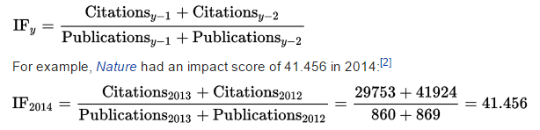
Journal Impact Factor
The Journal Impact Factor is defined as all citations to the journal in the current JCR year to items published in the previous two years, divided by the total number of scholarly items (these comprise articles, reviews, and proceedings papers) published in the journal in the previous two years.
(http://ipscience-help.thomsonreuters.com/incitesLiveJCR/glossaryAZgroup/g8/4346-TRS.html)
(https://en.wikipedia.org/wiki/Impact_factor)

Slide 12
Gini coefficient of 1 (100%) expresses perfect inequality
A Gini coefficient of 0 (0%) expresses perfect equality

Slide 13
Why Not?
IF = Citations / Publications
~ New Journals appearing, some Journals disappearing
~ Journals Renamed (rare)
Time

Slide 14
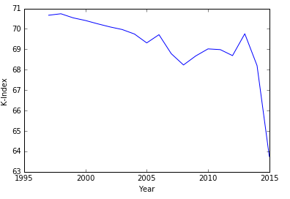
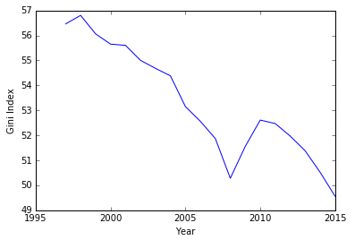
Gini-Index v.s K-Index

Slide 15
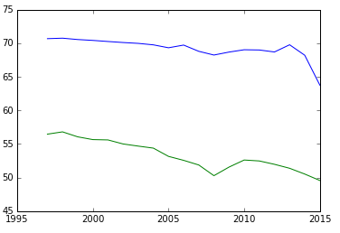

Slide 16
Expanding the coverage of Web of Science, in November 2009 Thomson Reuters introduced Century of Social Sciences. This service contains files which trace social science research back to the beginning of the 20th century,^{[7][8]}and Web of Science now has indexing coverage from the year 1900 to the present.^{[9][10]} As of 3 September 2014, the multidisciplinary coverage of the Web of Science encompasses over 50,000 scholarly books, 12,000 journals and 160,000 conference proceedings.^{[11]} The selection is made on the basis of impact evaluations and comprise open-access journals, spanning multiple academic disciplines. The coverage includes: the sciences, social sciences, arts, and humanities, and goes across disciplines.^{[9][12]} However, Web of Science does not index all journals, and its coverage in some fields is less complete than in others.
Furthermore, as of September 3, 2014 the total file count of the Web of Science was 90 million records, which included over a billion cited references. This citation service on average indexes around 65 million items per year, and it is described as the largest accessible citation database.^{[12]}
Titles of foreign-language publications are translated into English and so cannot be found by searches in the original language.^{[13]}

